Slide 1
Capstone Project - The Battle of Neighborhoods

Slide 2
Introduction
New York City's demographics show that it is a large and ethnically diverse metropolis. It is the largest city in the United States with a long history of international immigration. New York City was home to nearly 8.5 million people in 2014, accounting for over 40% of the population of New York State and a slightly lower percentage of the New York metropolitan area, home to approximately 23.6 million. Over the last decade the city has been growing faster than the region. The New York region continues to be by far the leading metropolitan gateway for legal immigrants admitted into the United States.

Slide 3
Data
For this project we need the following data :
New York City data that contains list Boroughs, Neighborhoods along with their latitude and longitude.
Data source : https://cocl.us/new_york_dataset
Description : This data set contains the required information. And we will use this data set to explore various neighborhoods of new york city.
Indian resturants in each neighborhood of new york city.
Data source : Fousquare API
Description : By using this api we will get all the venues in each neighborhood. We can filter these venues to get only indian resturants.
GeoSpace data
Data source : https://data.cityofnewyork.us/City-Government/Borough-Boundaries/tqmj-j8zm
Description : By using this geo space data we will get the New york Borough boundaries that will help us visualize choropleth map.

Slide 4
Approach
Collect the new york city data from https://cocl.us/new_york_dataset
Using FourSquare API we will find all venues for each neighborhood.
Filter out all venues that are Indian Resturants.
Find rating , tips and like count for each Indian Resturants using FourSquare API.
Using rating for each resturant , we will sort that data.
Visualize the Ranking of neighborhoods using folium library(python)

Slide 5
Questions that can be asked using the above mentioned datasets
What is best location in New York City for Indian Cuisine ?
Which areas have potential Indian Restaurant Market ?
Which all areas lack Indian Restaurants ?
Which is the best place to stay if I prefer Indian Cuisine ?
Analysis
We will import the required libraries for python.
pandas and numpy for handling data.
request module for using FourSquare API.
geopy to get co-ordinates of City of New York.
folium to visualize the results on a map

Slide 6
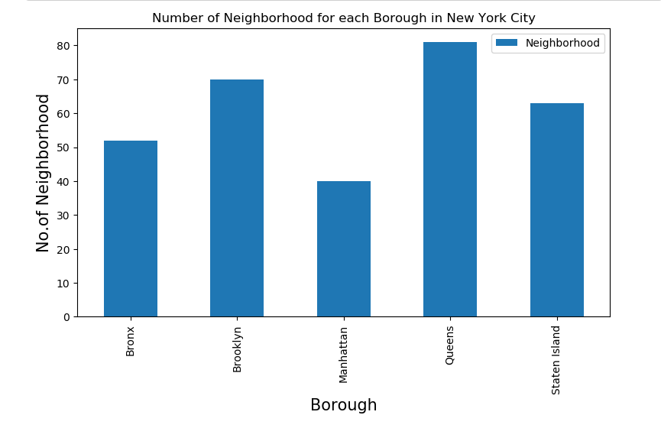

Slide 7
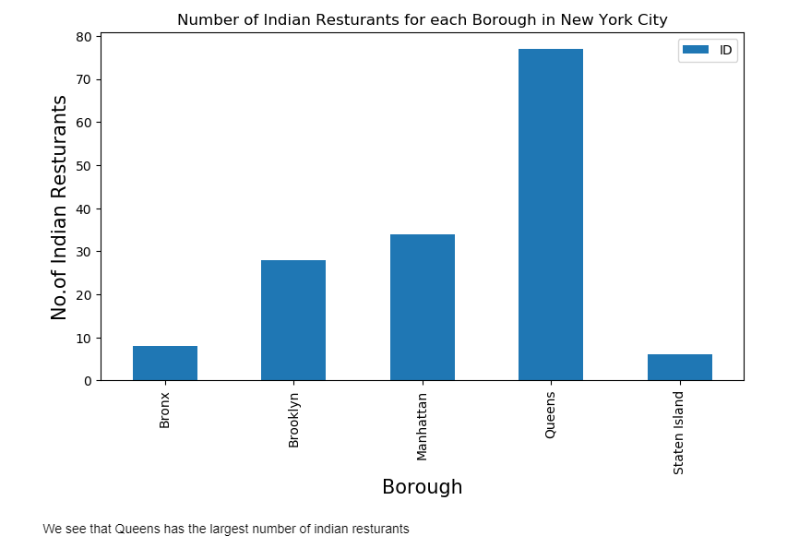

Slide 8
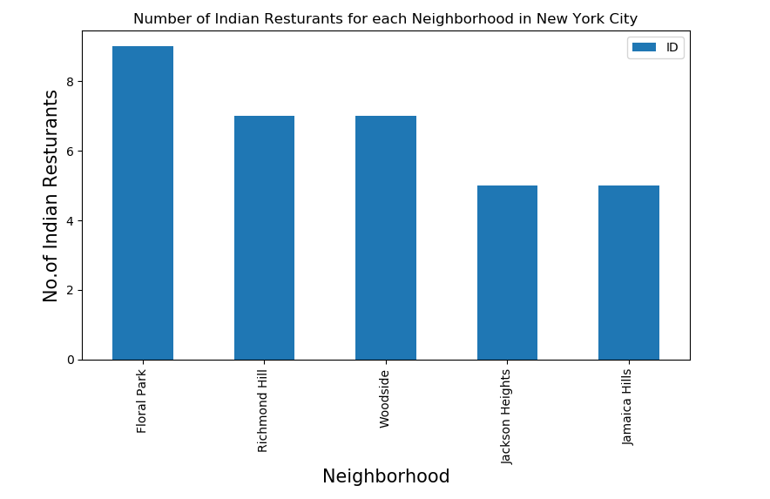

Slide 9
Limitations
The ranking is purely on basis of rating of resturants
The accuracy of data depends purely on the data provided by Foursquare
Conclusion
Astoria(Queens), Blissville(Queens), Civic Center(Manhattan) are some of the best neighborhoods for indian cuisine.
Manhattan have potential Indian Resturant Market/
Staten Island ranks last in average rating of Indian Resturants.
Manhattan is the best place to stay if you prefer Indian Cuisine.

